Slide 1
DATA PROGRAMMING BDAT 1004
FIFA PLAYER ANALYSIS
By Yash Solanki
Student no. :- 200474409
Batch :- D

Slide 2

Introduction to Dataset
FIFA is a non-profit organization that describes itself as an international governing body of association football, futsal and beach soccer. It is the highest governing body of association football.
Dataset includes attributes based on actual data of EA's FIFA 18 game.
Dataset includes player’s personal data like Nationality, Club, Age , Wage, Salary etc.

Slide 3
Source of Dataset
The data was scrapped from the sofifa website using a python crawling script. The website contains the data from the EA Sports' game FIFA and gets updated regularly with the release of new versions of the game. data developed by Electronic Arts for the latest edition(2018) of their FIFA game franchise. Through several research projects done on soccer analytics, it has been established in the field of academia that the use of data from the FIFA franchise has several merits that traditional datasets based on historical data do not offer. Since 1995 the FIFA Soccer games provide an extensive and coherent scout of players worldwide.

Slide 4
Why this dataset?
The dataset has a reasonable mix of both continuous and categorical variables.
Several insights and correlations between player value, wage, age, and performance can be derived from the dataset.
This uninterpreted data can be converted into information by analyzing it.

Slide 5
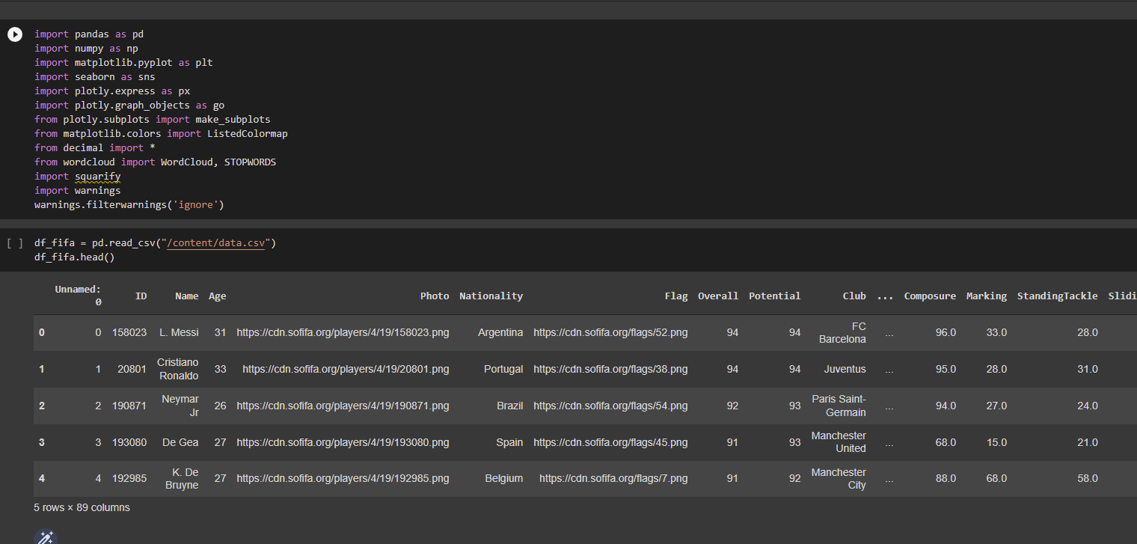
Loading & Data Cleaning

Slide 6
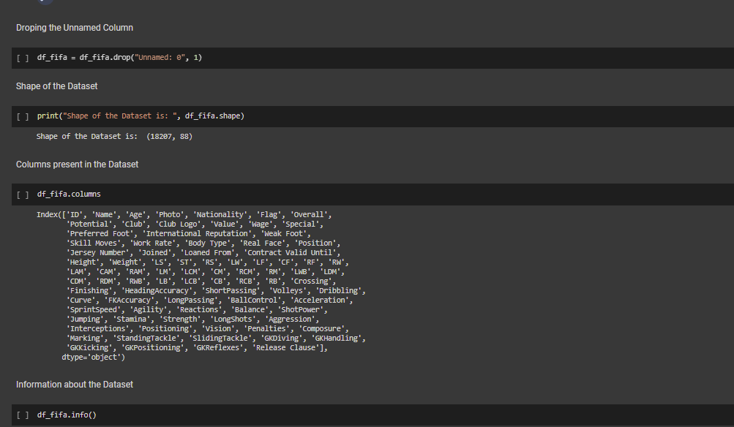
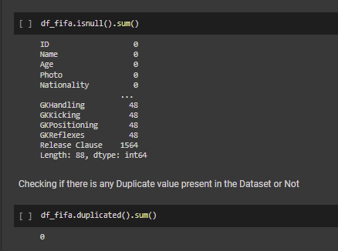

Slide 7
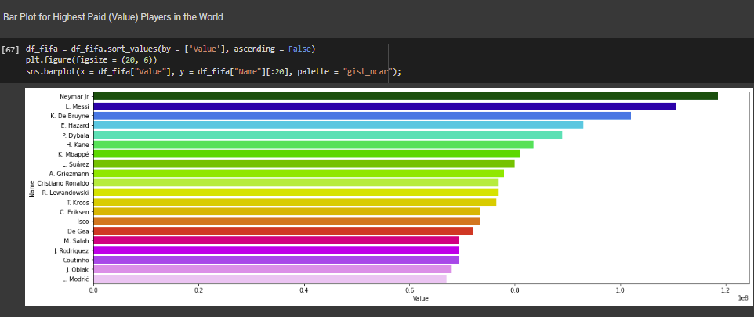
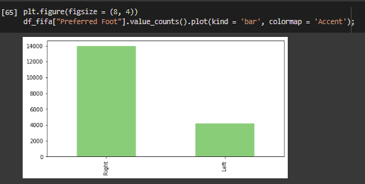
Data Visualization

Slide 8
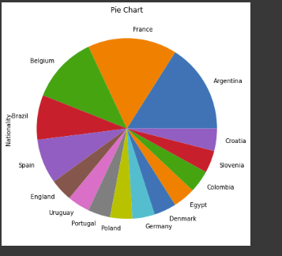
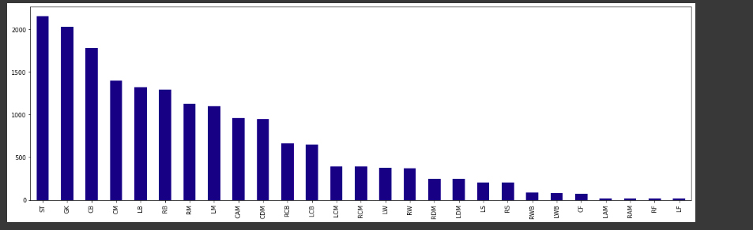
Data Visualization

Slide 9

Reference
Dataset
The data is scraped from the website https://sofifa.com by extracting the Player personal data, followed by Player IDs and their playing and style statistics.
https://github.com/4m4n5

Slide 10
THANK YOU
Any questions?

